Slide 1
UNIT- IV SYLLABUS Genetic Algorithms – Motivation, Genetic algorithms, an illustrative example, hypothesis space search, genetic programming, models of evolution and learning, parallelizing genetic algorithms. Learning Sets of Rules – Introduction, sequential covering algorithms, learning rule sets: summary, learning First-Order rules, learning sets of First-Order rules: FOIL, Induction as inverted deduction, inverting resolution. Reinforcement Learning – Introduction, the learning task, Q–learning, non-deterministic, rewards and actions, temporal difference learning, generalizing from examples, relationship to dynamic programming.

Slide 2
TOPICS
1. Genetic Algorithms:
1.1. Introduction & Prototypical GA
1.2. Representing Hypothesis
1.3. Genetic Operators
1.4. Fitness Function and Selection
1.5. An Illustrative Example
1.6. Hypothesis Space Search
2. Genetic Programming :
2.1. Representing Programs
2.2. Illustrative Example

Slide 3
Genetic Algorithm Introduction
Genetic algorithms provide a learning method motivated by an analogy to biological evolutions.
GAs generate successor hypotheses by repeatedly mutating and recombining parts of the best currently known hypotheses
A collection of hypotheses called the current population is updated by replacing some fraction of the population by offspring of the most fit current hypotheses

Slide 4
The popularity of GA’s is motivated by a number of factors including:
Evolution is known to be a successful, robust method for adaptation within biological systems
GA’s can search spaces of hypotheses containing complex interacting parts, where the impact of each part on overall hypothesis fitness may be difficult to model
Genetic algorithms are easily parallelized and can take advantage of the decreasing costs of powerful computer hardware

Slide 5
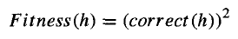
GENETIC ALGORITHMS
GA searches a space of candidate hypotheses to identify the best hypothesis
In GAs the "best hypothesis" is defined as the one that optimizes a predefined numerical measure for the problem at hand, called the hypothesis Fitness.
For a given training examples of its input and output, then fitness could be defined as the accuracy of the hypothesis over this training data

Slide 6
Structure of GA
The algorithm operates by iteratively updating a pool of hypotheses, called the population
On each iteration, all members of the population are evaluated according to the fitness function
A new population is then generated by probabilistically selecting the most fit individuals from the current population
Some of these selected individuals are carried forward into the next generation population intact
Create new offspring individuals by applying genetic operations such as crossover and mutation

Slide 7
Representing Hypothesis
Hypotheses in GAs are often represented by bit strings(chromosomes), so that they can be easily manipulated by genetic operators such as mutation and crossover.
Examples:
Outlook 🡪 Sunny, Overcast, or Rain.
Outlook = Overcast 🡪 010
Outlook = Overcast v Rain 🡪 011
Most general possible constraint 🡪 111

Slide 8
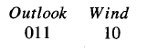
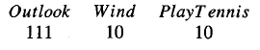
Representing Hypothesis(cont..
Wind -> Strong , Weak

Slide 9
Genetic operations
The generation of successors in a GA is determined by a set of operators that recombine and mutate selected members of the current population
The two most common operators are crossover and mutation
The crossover operator produces two new offspring from two parent strings, by copying selected bits from each parent

Slide 10
Genetic operations (cont..
The bit at position i in each offspring is copied from the bit at position i in one of the two parents. The choice of which parent contributes the bit for position i is determined by an additional string called the crossover mask.
Based on crossover mask value crossover operation executes in three ways.
Single point crossover
Two point crossover
Uniform crossover

Slide 11
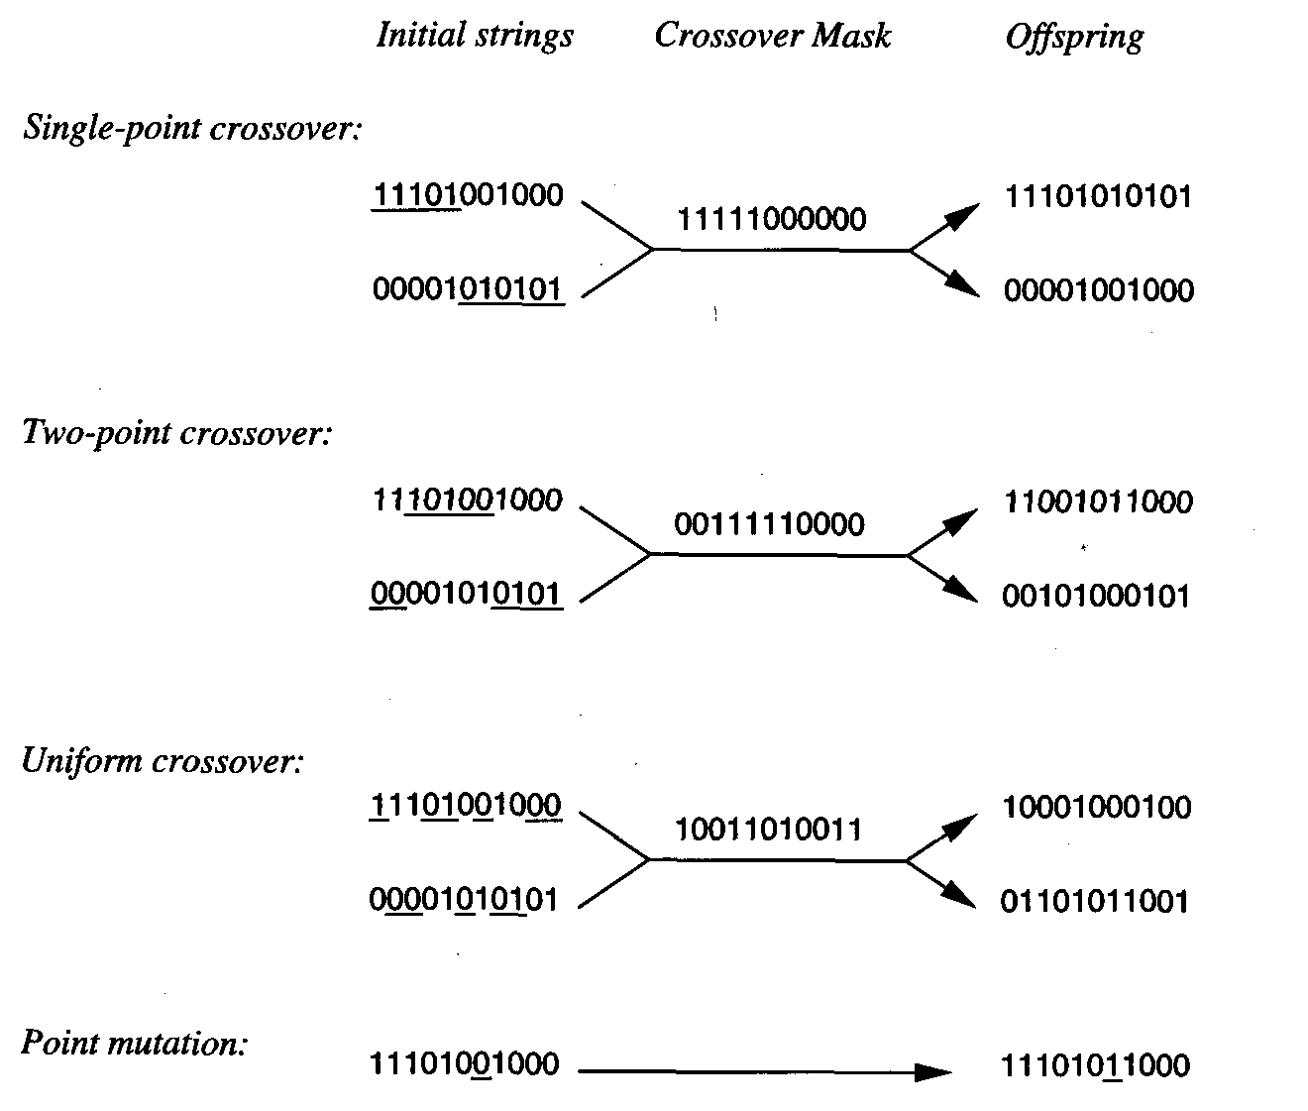
Genetic operations (cont..

Slide 12
Fitness function and selection
In prototypical GA , the probability that a hypothesis will be selected is given by the ratio of its fitness to the fitness of other members of the current population. This method is sometimes called fitness proportionate selection, or roulette wheel selection.
Tournament selection, two hypotheses are first chosen at random from the current population. With some predefined probability p the more fit of these two is then selected, and with probability (1 - p) the less fit hypothesis is selected.
Rank selection, the hypotheses in the current population are first sorted by fitness. The probability that a hypothesis will be selected is then proportional to its rank in this sorted list, rather than its fitness.

Slide 13
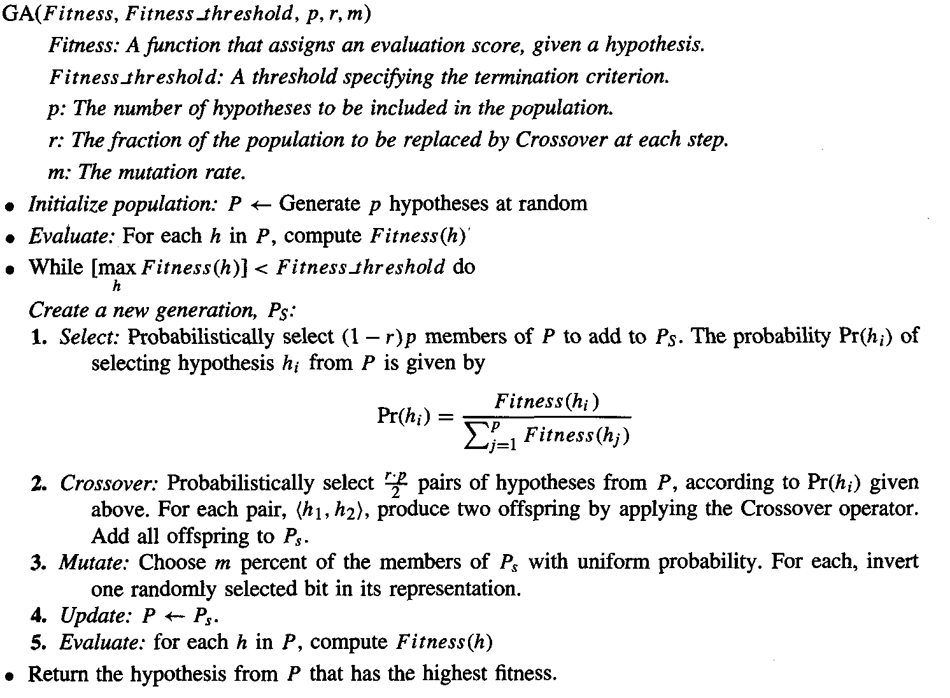
A prototypical Genetic Algorithm

Slide 14
An illustrative example
GABIL uses a GA to learn boolean concepts represented by a disjunctive set of propositional rules.
In experiments over several concept learning problems, GABIL was found to be roughly comparable in generalization accuracy to other learning algorithms such as the decision tree learning algorithm C4.5 and the rule learning system AQ14.
The algorithm used by GABIL is exactly the prototypical genetic algorithm.

Slide 15
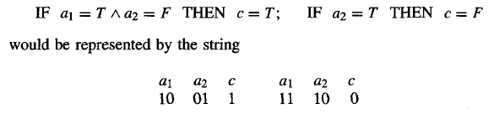
An illustrative example(cont…
To illustrate, consider a hypothesis space in which rule preconditions are conjunctions of constraints over two boolean attributes, a1 and a2. The rule post condition is described by a single bit that indicates the predicted value of the target attribute c. Thus, the hypothesis consisting of the two rules.

Slide 16
1.5. An illustrative example … Contd.
To illustrate, consider a hypothesis space in which rule preconditions are conjunctions of constraints over two Boolean attributes, a1 and a2. The rule post condition is described by a single bit that indicates the predicted value of the target attribute c. Thus, the hypothesis consisting of the two rules.

Slide 17
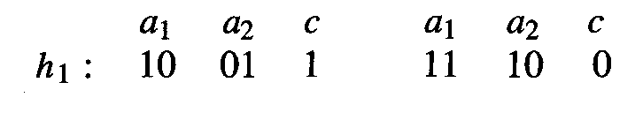
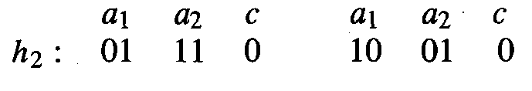
1.5. An illustrative example … Contd.
GABIL uses the standard mutation operator in which a single bit is chosen at random and replaced by its complement. The crossover operator that it uses is the two-point crossover operator.
For example, if the two parent strings are
crossover points chosen for the first parent are the points following bit positions 1 and 8,

Slide 18
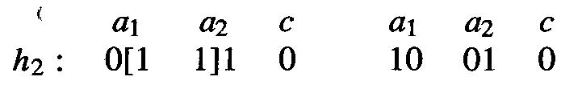
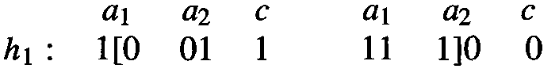
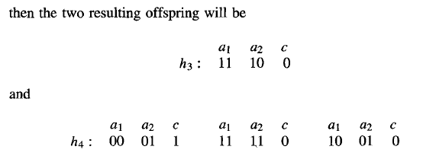
1.5. An illustrative example … Contd
crossover points chosen for the second parent are the points following bit positions 1 and 3,

Slide 19
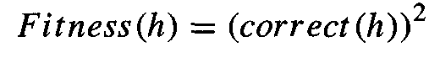
1.5. An illustrative example … Contd.
Fitness function. The fitness of each hypothesized rule set is based on its classification accuracy over the training data. In particular, the function used to measure fitness is
where correct (h) is the percent of all training examples correctly
classified by hypothesis h.

Slide 20
1.6. Hypothesis Space Search
GAs employ a randomized beam search method to seek a maximally fit hypothesis. This search is quite different from that of other learning methods.
The GA search can move much more quickly, replacing a parent hypothesis by an offspring that may be radically different from the parent.

Slide 21
1.6. Hypothesis Space Search …Contd.
Crowding is a phenomenon in which some individual that is more highly fit than others in the population quickly reproduces, so that copies of this individual and very similar individuals take over a large fraction of the population.
The negative impact of crowding is that it reduces the diversity of the population, thereby slowing further progress by the GA.

Slide 22
1.6. Hypothesis Space Search …Contd.
Several strategies have been explored for reducing crowding. One approach is to alter the selection function.
Using tournament selection or rank selection criteria in place of fitness proportionate.
A related strategy is "fitness sharing," in which the measured fitness of an individual is reduced by the presence of other, similar individuals in the population.
A third approach is to restrict the kinds of individuals allowed to recombine to form offspring

Slide 23
Population Evolution and the Schema Theorem
a schema is any string composed of Os, Is, and *'s.
For example, the schema 0*10 represents the set of bit strings that
includes exactly 0010 and 01 10.
For example, the bit string 0010 can be thought of as a
representative of 24 distinct schemas including 00**, O* 10, ****
etc
a population of bit strings can be viewed in terms of the set of
schemas that it represents and the number of individuals associated
with each of these schema
The schema theorem characterizes the evolution of the population within a GA in terms of the number of instances representing each schema.

Slide 24
Let m(s, t) denote the number of instances of schema s in the population at time t (i.e., during the tth generation). The schema theorem describes the expected value of m(s, t + 1) in terms of m(s, t) and other properties of the schema, population, and
GA algorithm parameters.
The evolution of the population in the GA depends on the selection step, the recombination step, and the mutation step. Let us start by considering just the effect of the selection step. Let f (h) denote the fitness of the individual bit string h and denote the average fitness of all individuals in the population at time t. Let n be the total number of individuals in the population. Let
indicate that the individual h is both a representative of schema s and a member of the population at time t. Finally, let
u(s, t) denote the average fitness of instances of schema s in the population at time t.

Slide 25
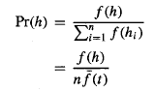
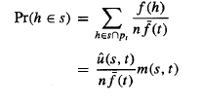
We can calculate expected value of m(s, t + l), which we denote E[m(s, t + I)] as follows.
Now if we select one member for the new population according to this probability distribution, then the probability that we will select a representative of schema s is

Slide 26
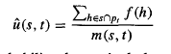
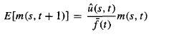
The second step above follows from the fact that by definition,
Therefore, the expected number of instances of s resulting from the n independent selection steps that create the entire new generation is just n times this probability.
While the above analysis considered only the selection step of the GA, the crossover and mutation steps must be considered as well.

Slide 27
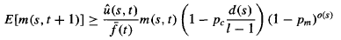
The full schema theorem thus provides a lower bound on the expected frequency of schema s, as follows:
Here, p, is the probability that the single-point crossover operator will be applied to an arbitrary individual, and p, is the probability that an arbitrary bit of an arbitrary individual will be mutated by the mutation operator. o(s) is the number I of defined bits in schema s, where 0 and 1 are defined bits, but * is not. d(s) is the distance between the leftmost and rightmost defined bits in s. Finally, 1 is the length of the individual bit strings in the population.
The middle term describes the effect of the single-point crossover operator.
The rightmost term describes the probability that an arbitrary individual representing schema s will still represent schema s following application of the mutation operator.

Slide 28
2. Genetic Programming
Genetic programming (GP) is a form of evolutionary computation in which the individuals in the evolving population are computer programs rather than bit strings.

Slide 29
2.1. Representing Programs
Programs manipulated by a GP are typically represented by trees corresponding to the parse tree of the program.
Each function call is represented by a node in the tree, and the arguments to the function are given by its descendant nodes.
As in a genetic algorithm, the prototypical genetic programming algorithm maintains a population of individuals (in this case, program trees).

Slide 30
2.1. Representing Programs …Contd.
On each iteration, it produces a new generation of individuals using selection, crossover, and mutation.
The fitness of a given individual program in the population is typically determined by executing the program on a set of training data.
Crossover operations are performed by replacing a randomly chosen sub tree of one parent program by a subtree from the other parent program.

Slide 31
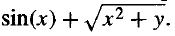
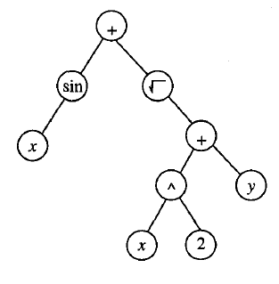
2.1. Representing Programs …Contd.
Example: the function

Slide 32
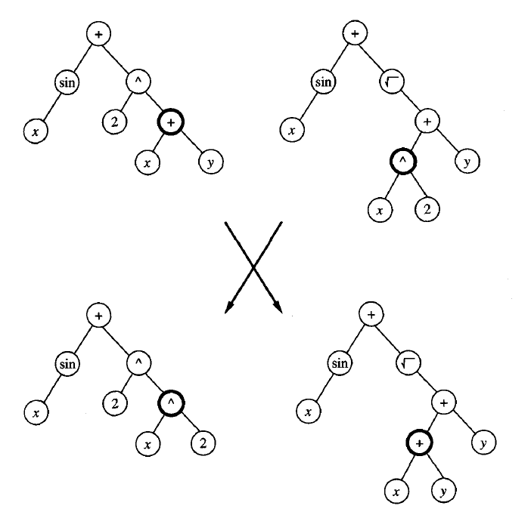
2.1. Representing Programs …Contd.
Crossover operation applied to two parent program trees.
Crossover operation applied to two parent program trees.

Slide 33
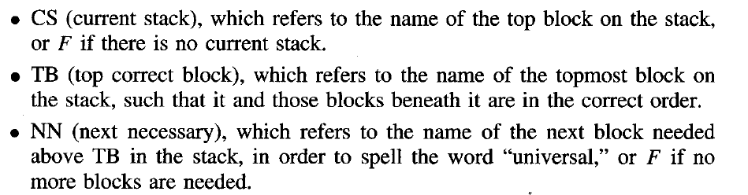
Illustrative Example
The task is to develop a general algorithm for stacking the blocks into a single stack that spells the word "universal,“
In Koza's formulation, the primitive functions used to compose programs for this task include the following three terminal arguments:

Slide 34
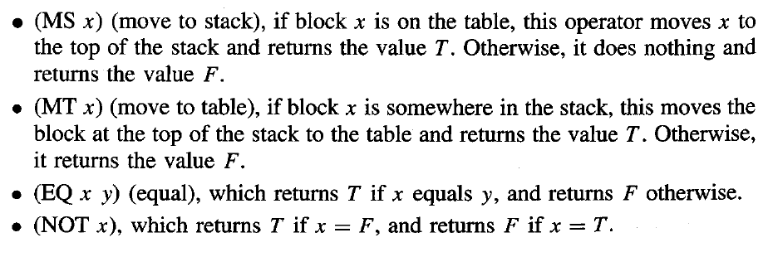
The program language in this application included the following primitive functions

Slide 35
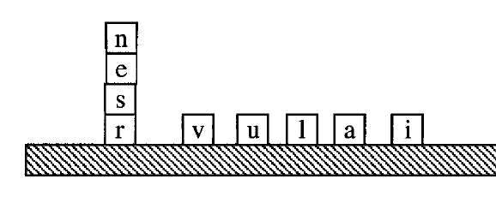
The population was initialized to a set of 300 random programs.
After 10 generations, the system discovered the following program, which solves all 166 problems

Slide 36
Remarks on Genetic Programming
GP search is fairly simple in several more complex tasks such as designing electronic filter circuits and classifying segments of protein molecules.

Slide 37
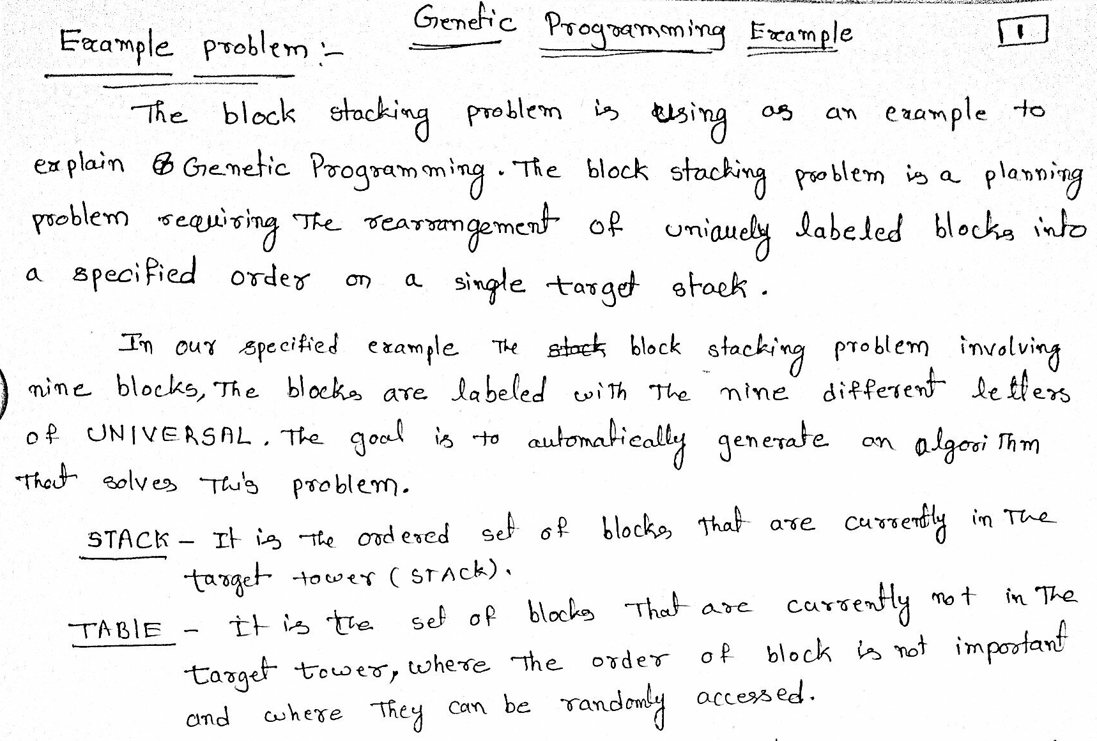

Slide 38
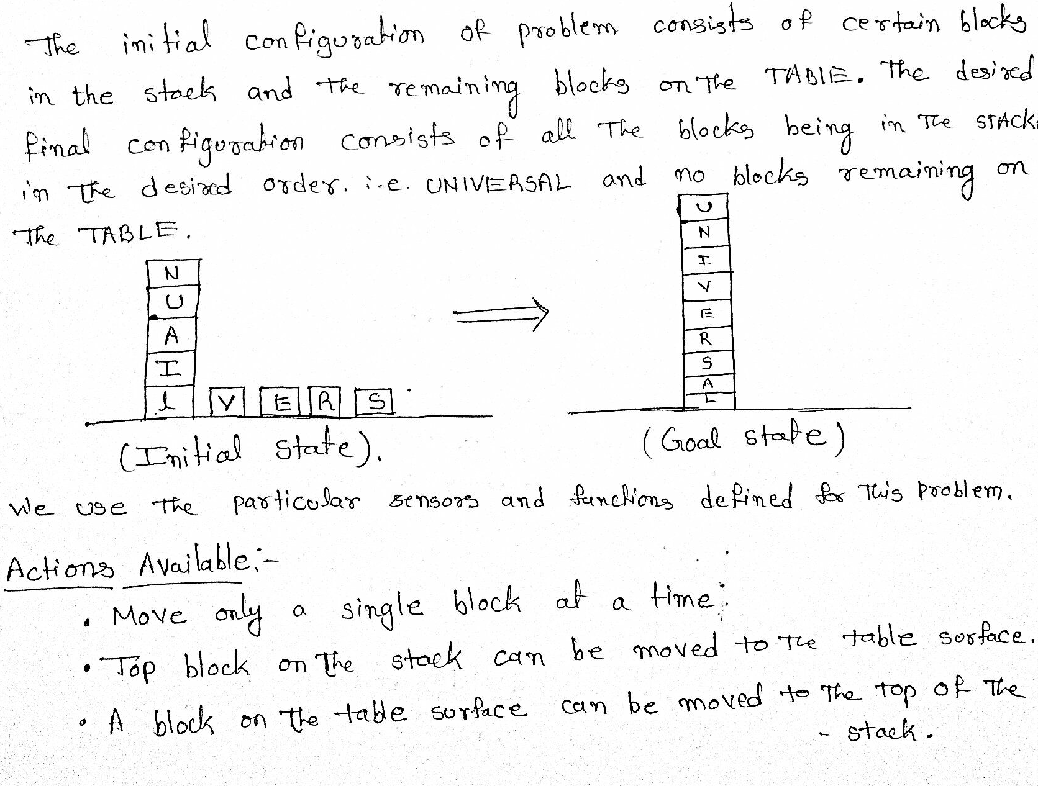
2.2. Illustrative Example … Contd.

Slide 39
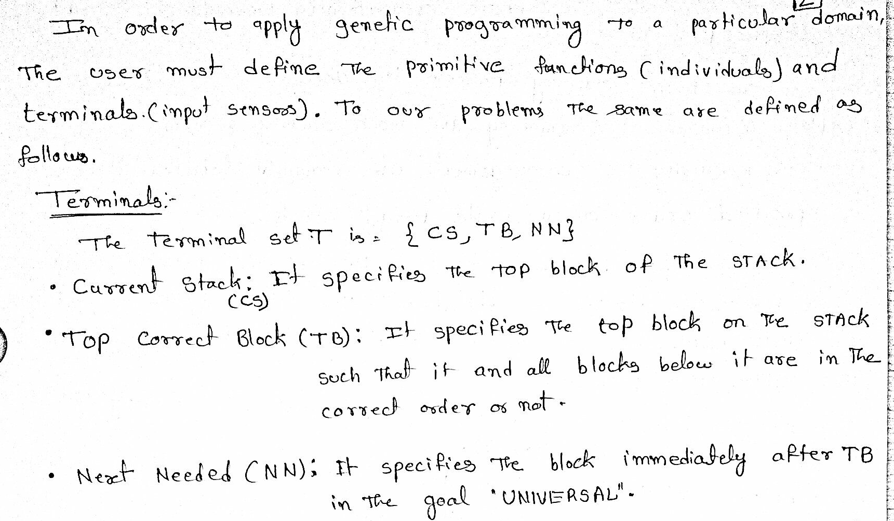
2.2. Illustrative Example … Contd

Slide 40
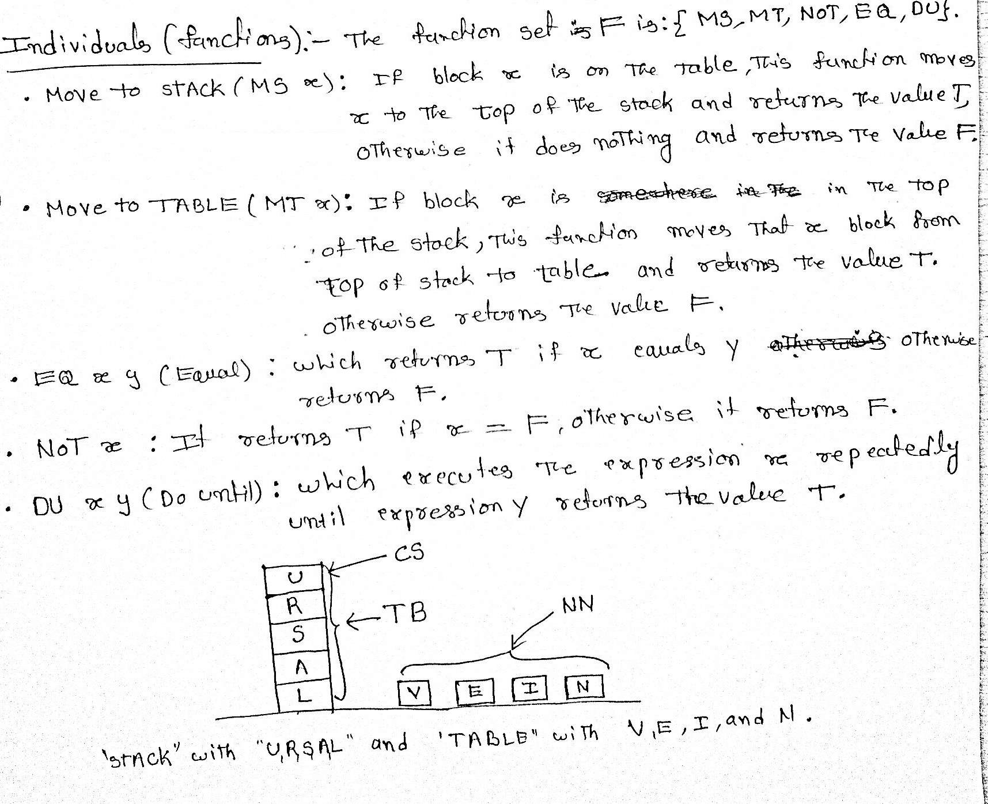
2.2. Illustrative Example … Contd.

Slide 41
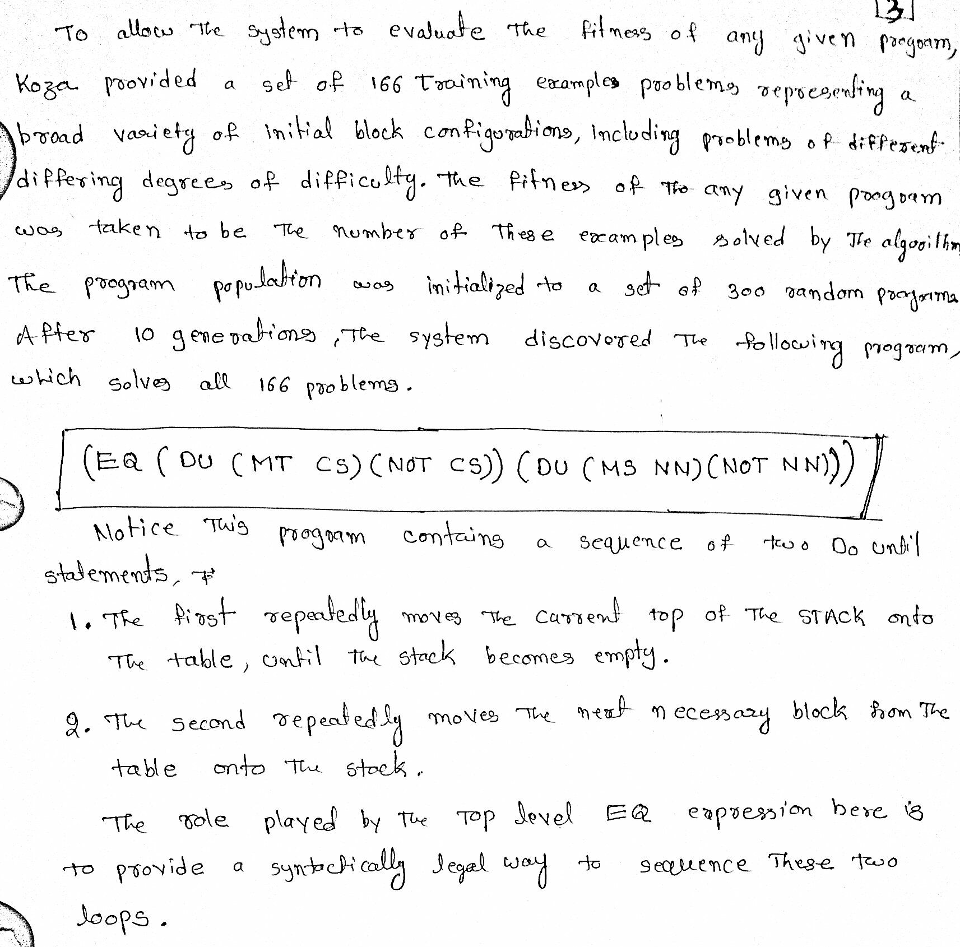
2.2. Illustrative Example … Contd.

Slide 42
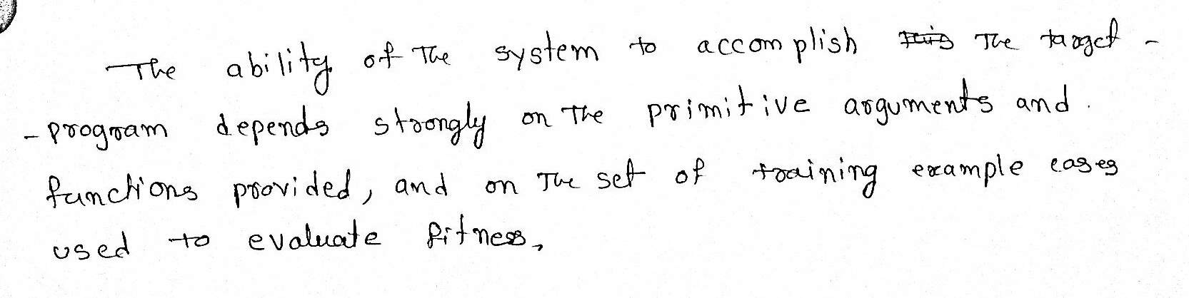
2.2. Illustrative Example … Contd.

Slide 43
MODELS OF EVOLUTION AND LEARNING
Lamarckian Evolution:
Lamarck was a scientist who, in the late nineteenth century, proposed that experiences of a single organism directly affected the genetic makeup of their offspring: If an individual learned during its lifetime to avoid some toxic food, it could pass this trait on genetically to its offspring, which therefore would not need to learn the trait. This is an attractive conjecture, because it would presumably allow for more efficient evolutionary progress than a generate-and-test process (like that of GAS and GPs) that ignores the experience gained during an individual's lifetime.

Slide 44
Baldwin Effect:
If a species is evolving in a changing environment, there will be evolutionary
pressure to favor individuals with the capability to learn during their lifetime. For example, if a new predator appears in the environment, then individuals capable of learning to avoid the predator will be more successful than individuals who cannot learn. In effect, the ability to learn allows an individual to perform a small local search during its lifetime to maximize its fitness. In contrast, nonlearning individuals whose fitness is fully determined by their genetic makeup will operate at a relative disadvantage.
Those individuals who are able to learn many traits will rely less strongly on their genetic code to "hard-wire" traits. As a result, these individuals can support a more diverse gene pool, relying on individual learning to overcome the "missing" or "not quite optimized" traits in the genetic code. This more diverse gene pool can, in turn, support more rapid evolutionary adaptation. Thus, the ability of individuals to learn can have an indirect accelerating effect on the rate of evolutionary adaptation for the entire population.

